Slide 1
DEVOPS CAPSTONE PRESENTATION
ClinicQ
Automated Cloud Delivery Platform

Slide 2


The Real-World Problem
Why traditional clinic booking systems fail.
Fragile Updates
Inconsistent Setup
Manual deployments cause costly downtime.
Code breaks across different machines.

Slide 3



The Mental Model
Docker
CI / CD
Kubernetes
Standardized shipping containers.
Automated security checkpoint.
Intelligent air traffic controller.

Slide 4


Local
Development
→
Spins up Postgres, FastAPI & React.
→
Identical environment across all machines.
→
Managed entirely via docker-compose.yml.

Slide 5

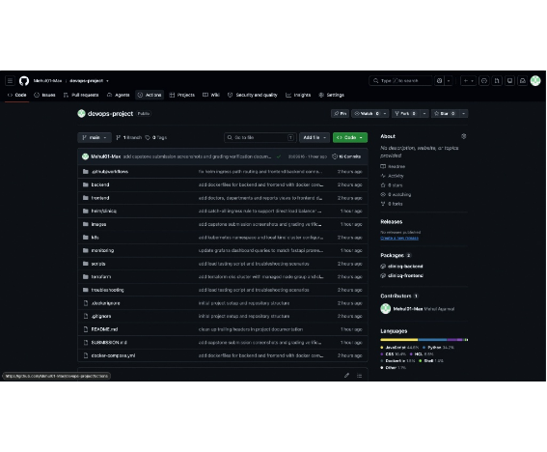
Structured
Codebase
→
19 progressive, documented commits.
→
Strict .gitignore blocks secret leaks.
→
Cleanly split into backend, frontend & IaC.

Slide 6
Strategic Decisions
COMPUTE
AUTOMATION
SECURITY
AWS EKS vs EC2
Actions vs Jenkins
Trivy vs Manual
Built for automated scaling.
Zero maintenance overhead.
Automated vulnerability blocking.

Slide 7

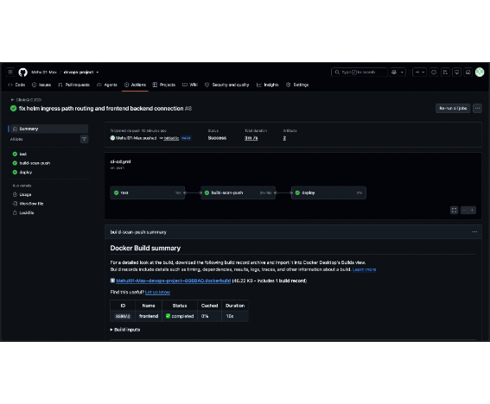
Automated
CI / CD
→
Passes 12/12 pytest cases first.
→
Trivy strictly blocks HIGH/CRITICAL CVEs.
→
Publishes SHA-tagged images to GHCR.

Slide 8

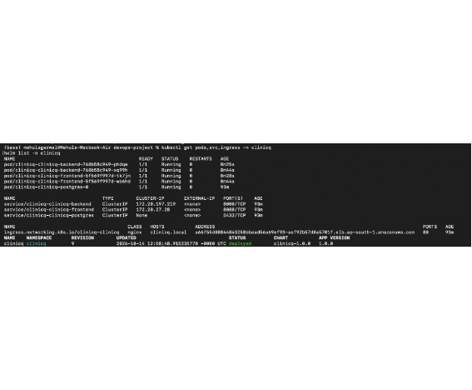
Production
Cloud
→
AWS EKS managed via Terraform.
→
Custom Helm chart deploys app replicas.
→
Traffic routed via Network Load Balancer.

Slide 9
Measurable Results
0
3m
100%
Security Vulnerabilities
Automated Release Time
Live Observability

Slide 10

Thank You.
github.com/Mehul01-Max/devops-project

